Slide 1
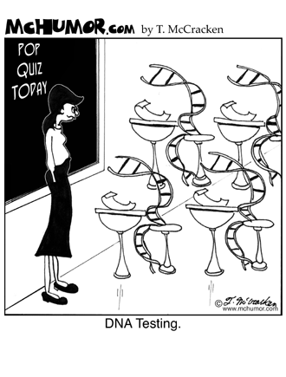
Biology: Exploring Life

Slide 2
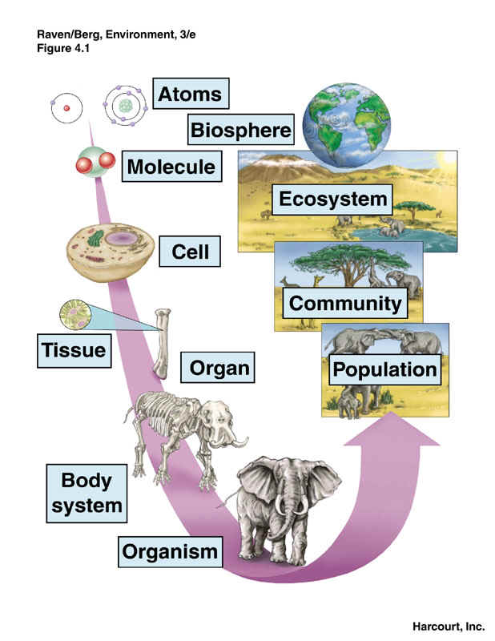
In life’s hierarchy of organization, new properties emerge at each level

Slide 3
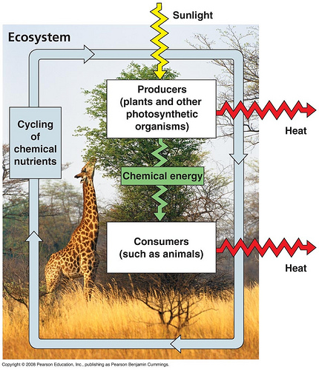
Living organisms interact with their environments, exchanging matter and energy

Slide 4
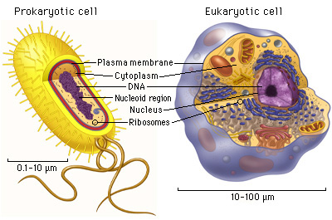
Cells are the structural and functional units of life.

Slide 5
The unity of life: all forms of life have common features
DNA
Order: All living things exhibit complex organization.
Regulation: The environment outside an organism may change markedly, but mechanisms maintain an organisms internal environment within limits that sustain life.
Growth and Development: Inherited information carried by genes controls the pattern of growth and development
Energy Processing: Organisms take in energy and transform it to perform all of life’s activities.
Response to the Environment: all organisms respond to environmental stimuli.
Evolutionary Adaptation: evolve over many generations

Slide 6
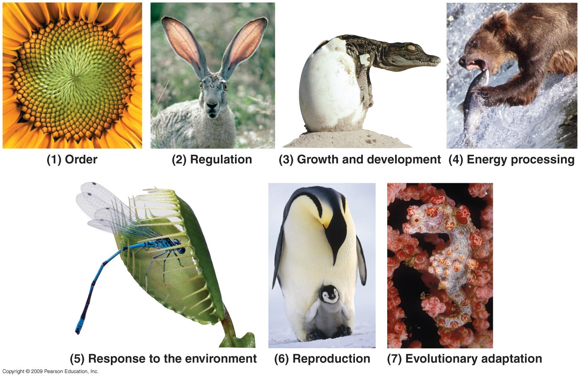

Slide 7
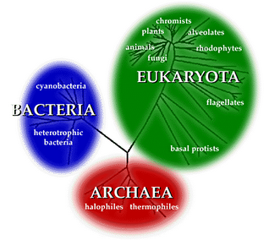
Diversity of life can be arranged into three domains

Slide 8
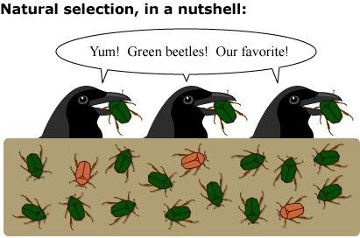
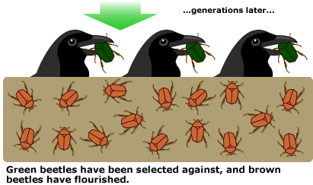
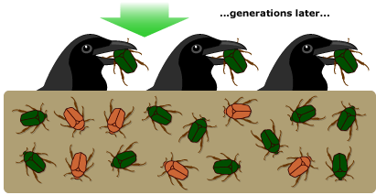
Evolution explains the unity and diversity of life.

Slide 9
Scientists use two main approaches to learn about nature
Discovery Science
Scientists observe and describe objects and phenomena
Hypothesis-Based Science
Scientists propose hypothesis, make deductions, and test predictions

Slide 10
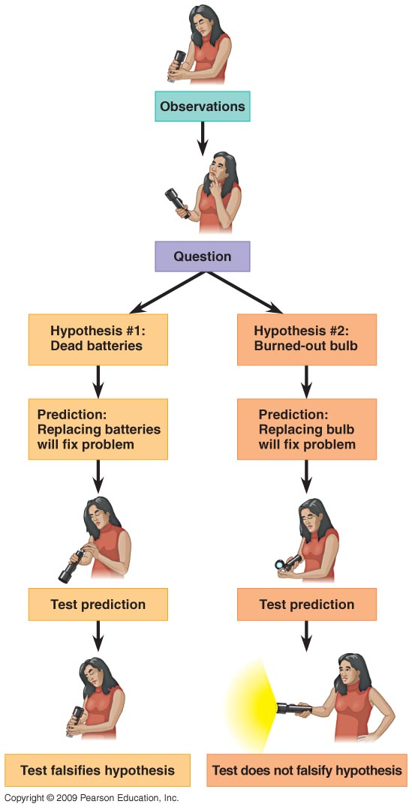

Slide 11
