Slide 1
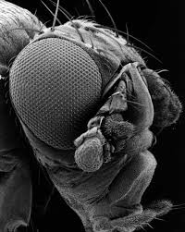
The Genetic Basis of Development
Scientists study mutations to understand normal development patterns.

Slide 2
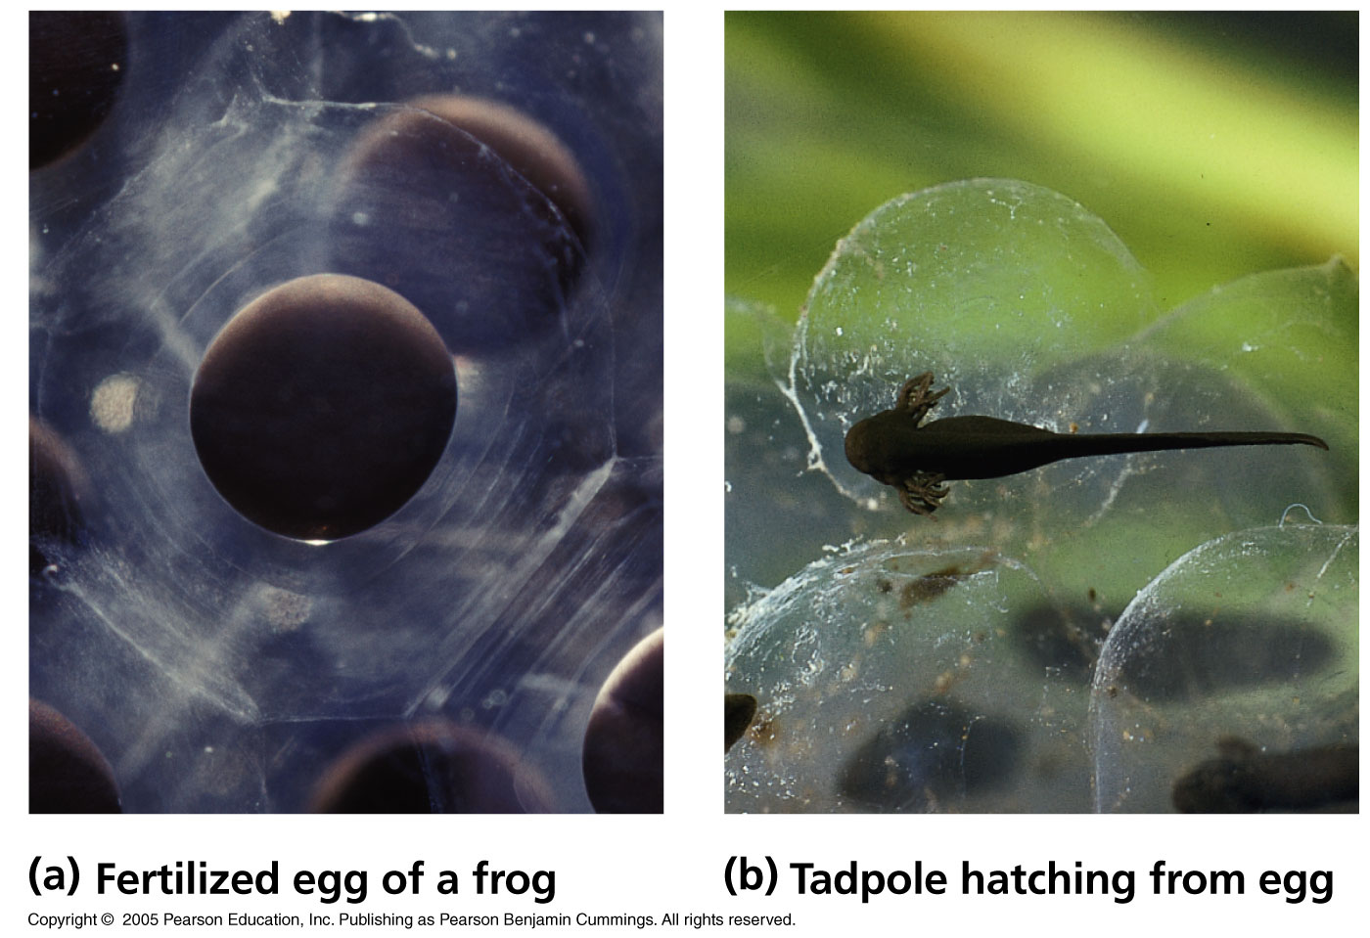
Embryonic development involves cell division, cell differentiation and morphogenesis.

Slide 3
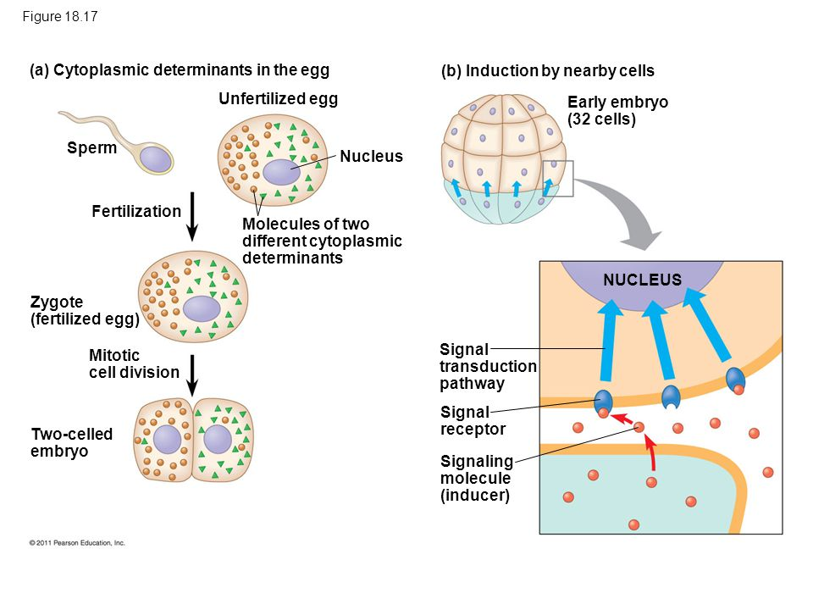
Sources of Developmental Information for the Early Embryo

Slide 4
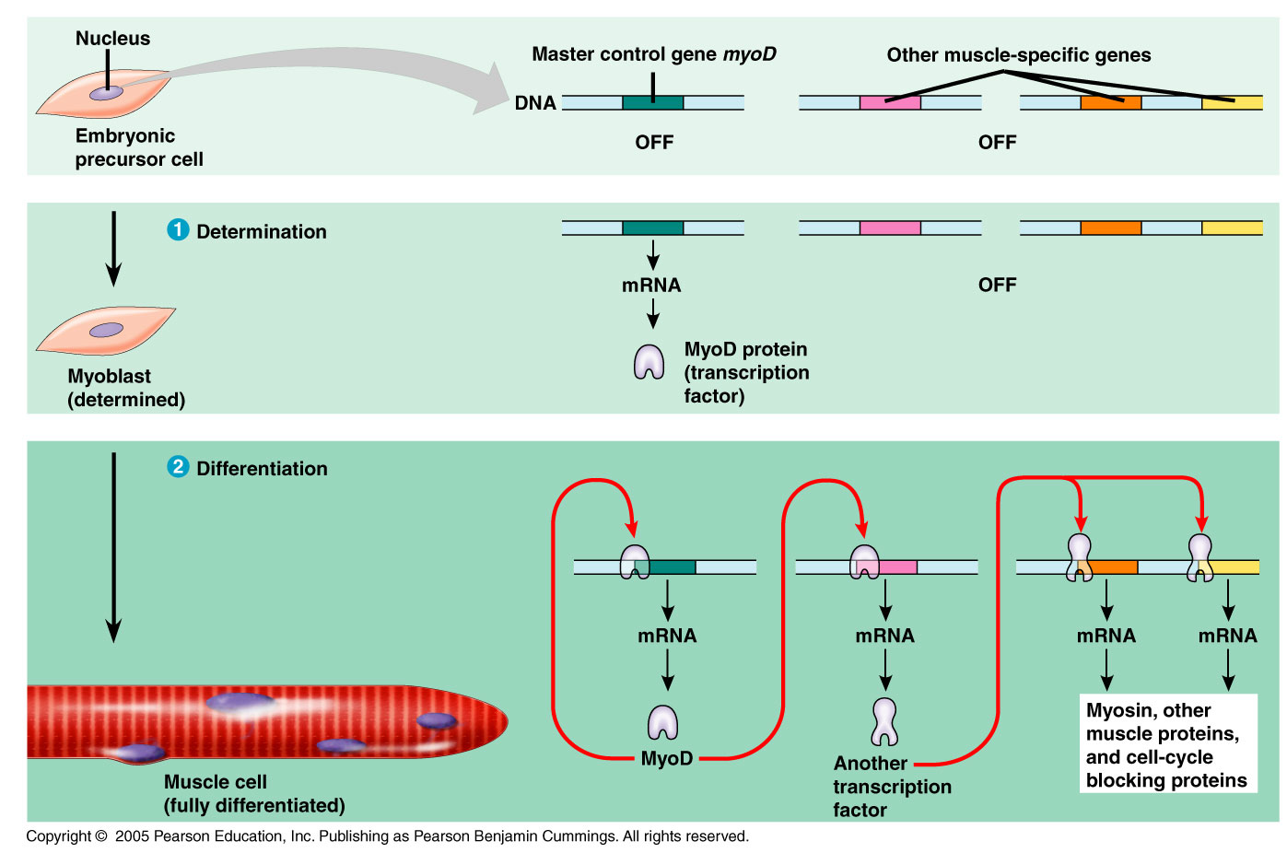
Determination and differentiation of muscle cells.

Slide 5
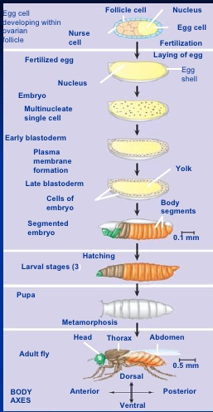
Homeotic Genes- determine where the body parts go.

Slide 6
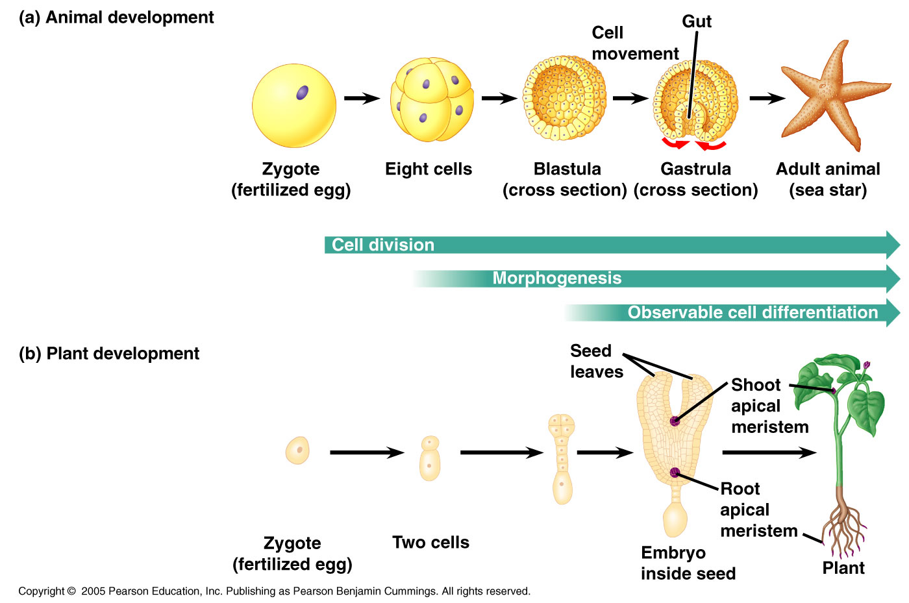
Some key stages of development in animals and plants.

Slide 7
Morphogenesis in Plants vs/ Animals
In animals, but not in plants, movement of cells and tissues are necessary to transform the early embryo into characteristic form of the organism.
In plants, but not in animals, morphogenesis and growth in overall size are not limited to embryonic and juvenile periods but occur throughout the life of the plant.
  Apical meristems.

Slide 8
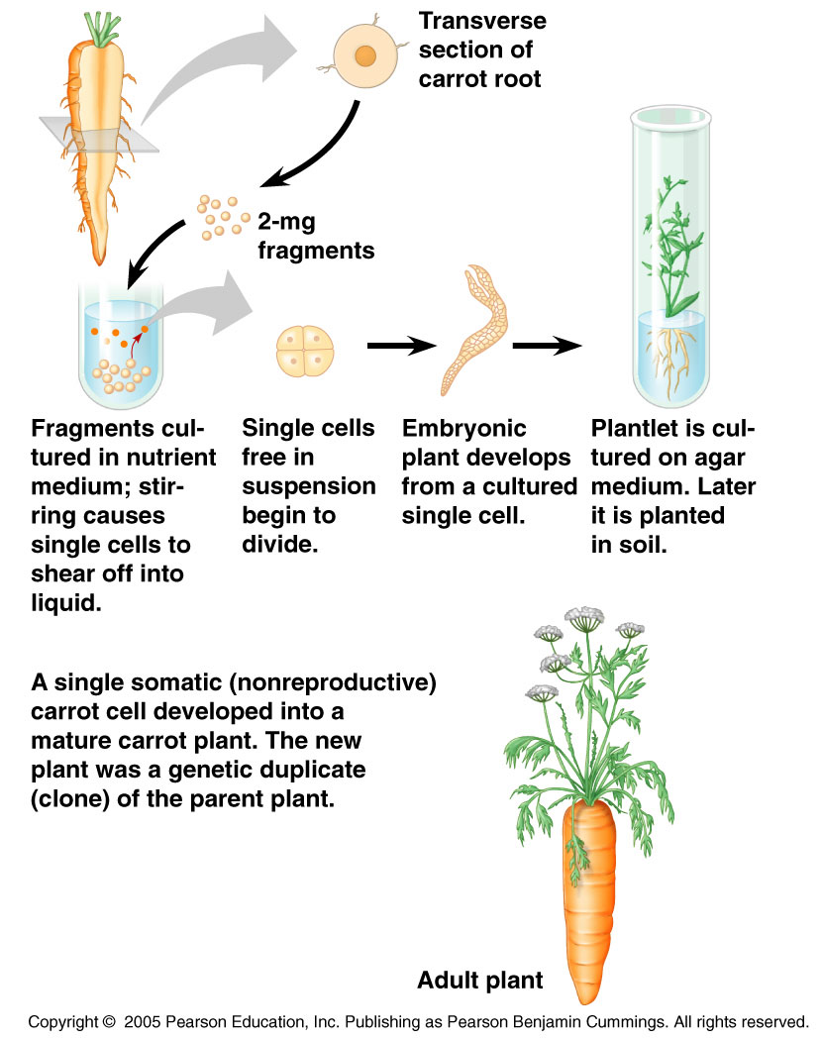
Evidence for Genomic Equivalence: Can a differentiated plant cell develop into a whole plant?

Slide 9
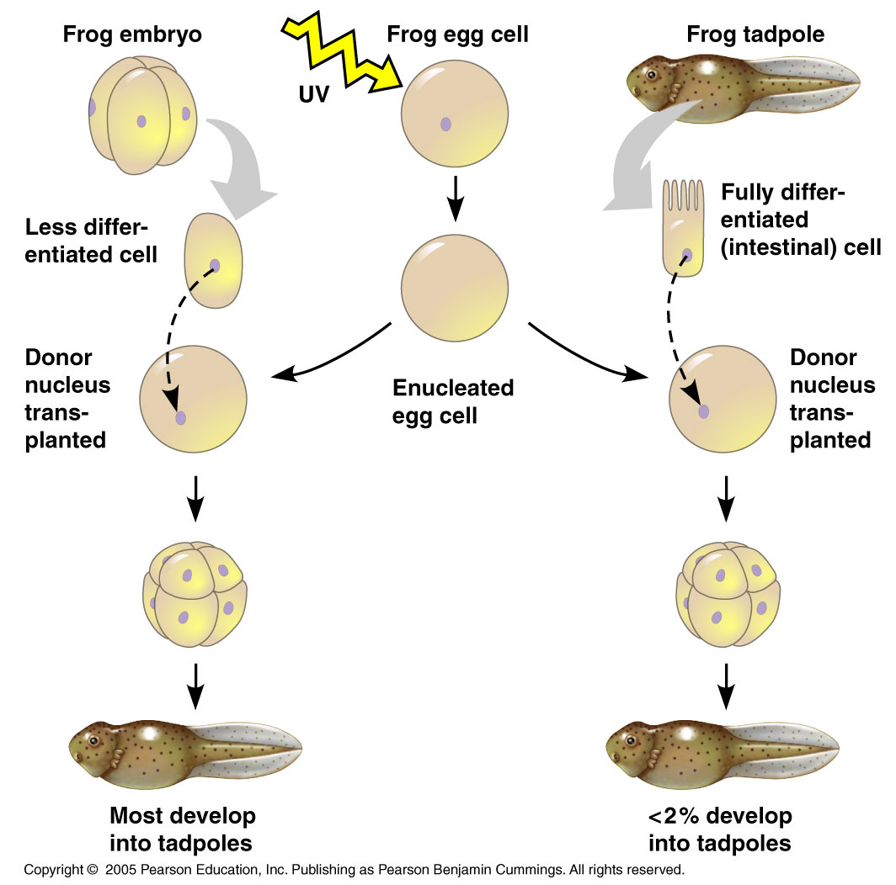
Can the nucleus from a differentiated animal cell direct the development of an organism?

Slide 10
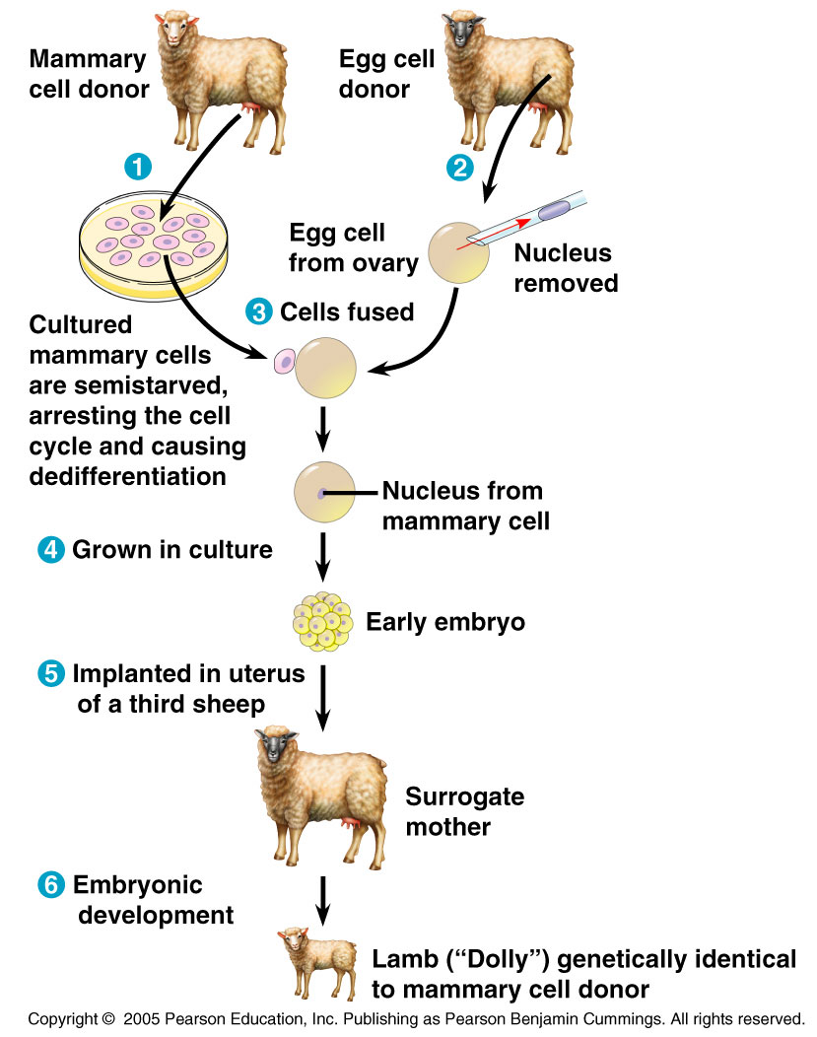
Reproductive Cloning of a Mammal by Nuclear Transplantation

Slide 11
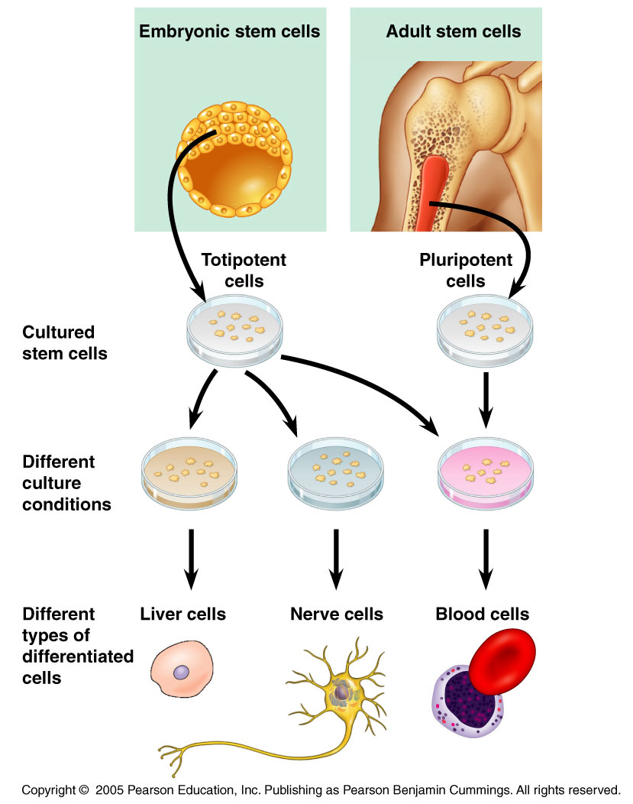
Working with stem cells

Slide 12
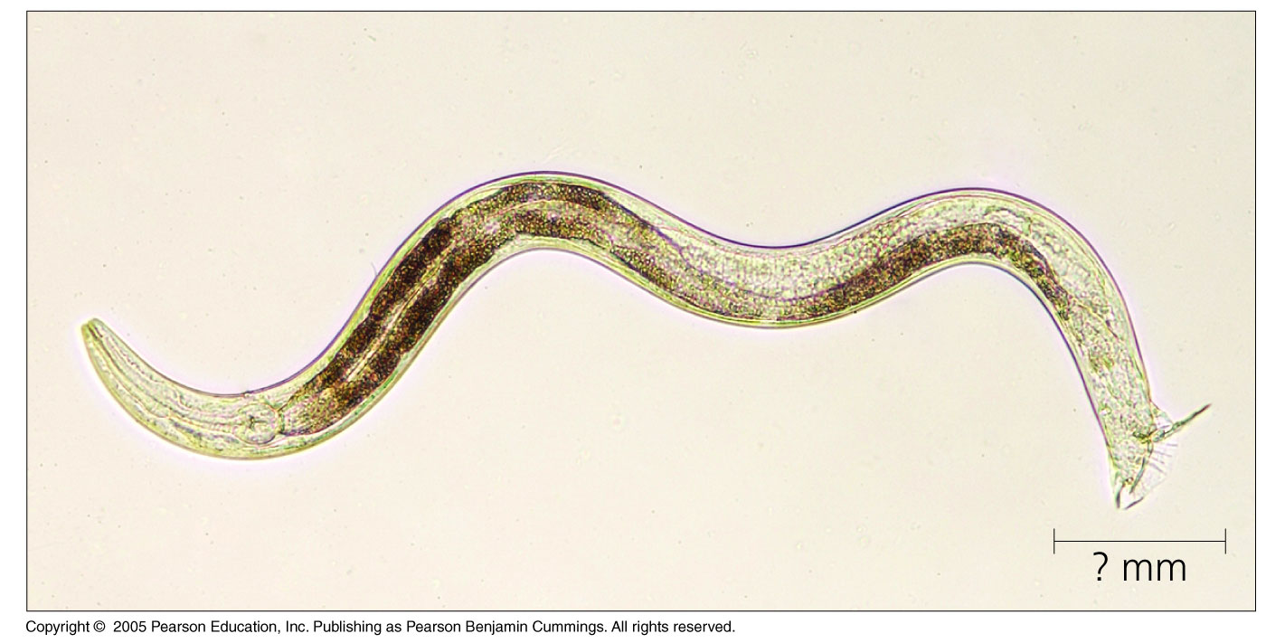
Model Organisms
What are some of the important criteria for model organisms chose for the study of developmental genetics?

